Slide 1
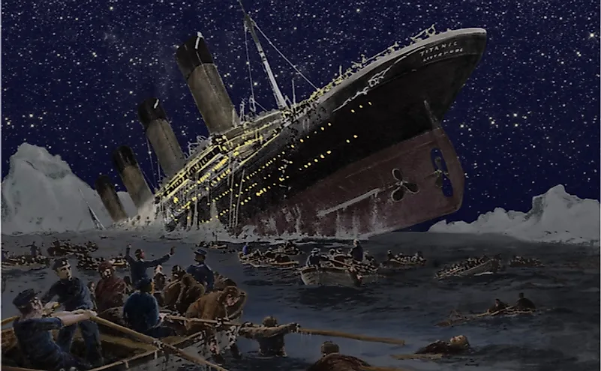

RMS Titanic disaster analysis
Teja Narayanan
BIS 232
24 May 2022.
Source: Department of Biostatistics at the Vanderbilt University School of Medicine and The Encyclopedia Titanica.
Notes:
Hello All, I am Teja Narayanan.
This presentation is for BIS 232 – Intro to Data viz and I will be walking you through my analysis of the RMS Titanic disaster.

Slide 2
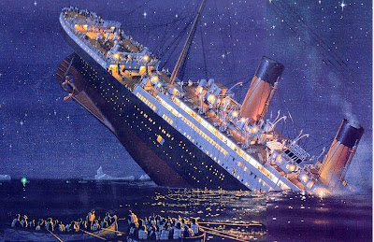
Background Information
RMS Titanic was a British passenger liner with an estimated 2,224 passengers on board.
Sank in the North Atlantic ocean on April 15, 1912.
More than 1,500 passengers (67% approx.) died in this maritime disaster.
This Photo by Unknown Author is licensed under CC BY-SA-NC
Notes:
First, a little bit of background information about the ship.

Slide 3
Project objective
Using the data analysis tool Tableau, this data driven presentation story will attempt to better understand the catastrophic Titanic disaster and its consequences.
Research questions
Understanding who were involved in the disaster
Who survived the disaster?
Notes:
At the end of this presentation, audience can expect to have a better understanding of who the passengers of Titanic were and who likely survived at the end of this catastrophic maritime disaster.
I hope to address two questions relating to who were involved in the journey and who survived?

Slide 4
Who travelled in the Titanic?
According to the Titanic dataset, a total of 1309 * passengers were on board at the time of the disaster.
This passenger list includes people from:
Ages between 0-85 years old.
Passenger classes 1,2,3 with 1 being most prestigious.
Binary sexes – male and female.
*This dataset includes only passenger count (excludes crew members)
Notes:
According to the source I have analyzed, this dataset contains only the passenger count meaning, the crew and cabin members details have been excluded.

Slide 5
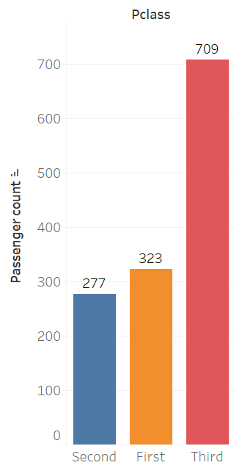
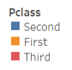
Who travelled in the Titanic? #pclass
Bar chart representing total passenger count based on P-class on RMS Titanic
Unpacking the visual:
Horizontal axis represents the 3 p-classes
Vertical axis shows the number of passengers in each p-class
Third class has maximum passengers (~ 54%)
Second class has the least (~21%)
Notes:
First, I want to calculate how many passengers from each of the social class travelled in Titanic.
As we can see, this is a column bar chart that represents total passenger count distinguished by three different colors indicating the 3 classes.

Slide 6
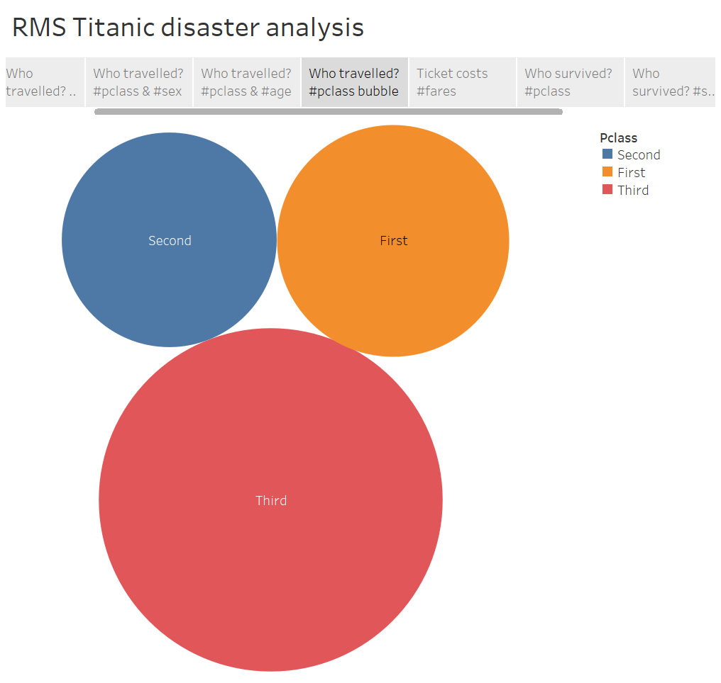
Who travelled in the Titanic? #pclass
Bubble chart displaying total passenger count based on P-class on RMS Titanic.
Notes:
Besides the bar chart, I find bubble charts significantly conveying the magnitude of the message. Based on one of the Gestalt principles, size is an important pre-attentive attributed and I think this chart plays a good role in indicating that members from the Third class were significantly more in number.
Additionally, the bar chart on the side helps to absorb the take-home message even more better.

Slide 7
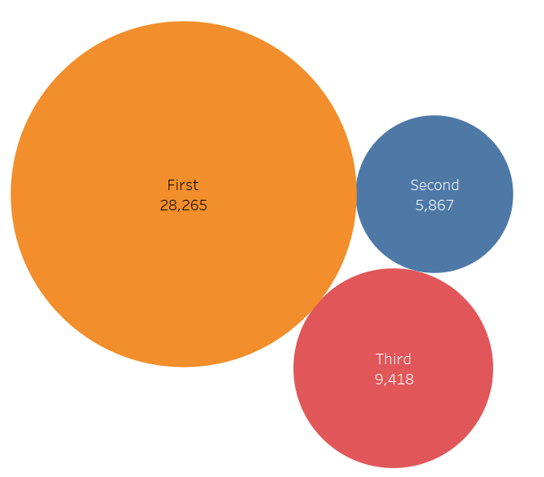
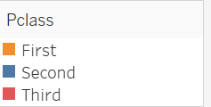
Who travelled in the Titanic? #pclass
Amount paid by passengers (in pounds) depending on the P-class cabin
Notes:
This is another prime example of size playing an important role in perception.
This bubble chart displays the total amount paid by passengers from the 3 p-classes.
We saw that third class was highest in occupancy, but they don’t contribute the most revenue. Instead, First class does. It is followed by Third class and Second class contributes the least to Titanic’s revenue which is understandable because there are very less passengers from it.

Slide 8
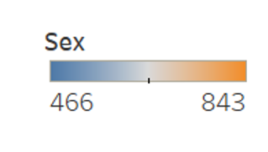
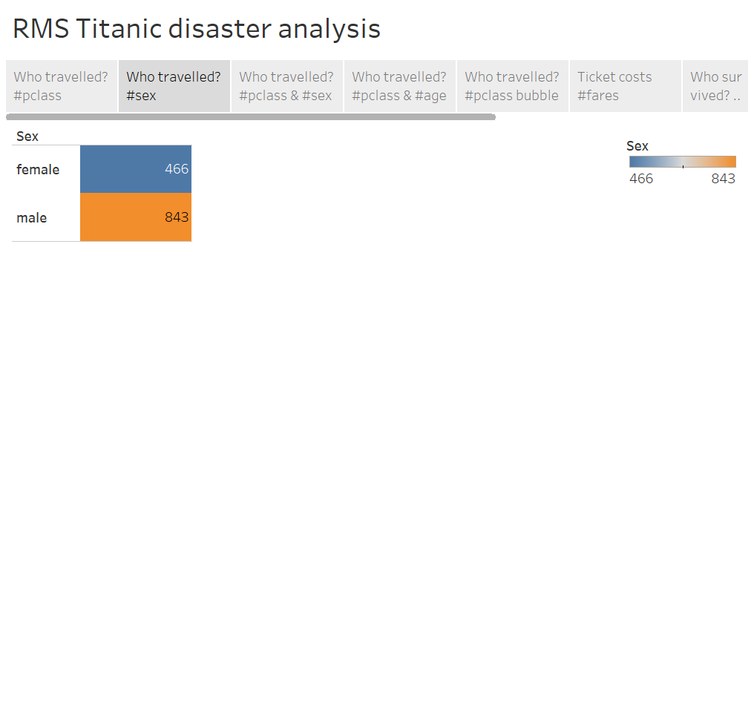
Who travelled in the Titanic? #gender
Table showing the distinct counts of females and males in the ship.
Number of males on the ship were almost 55% higher in proportion than number of females.
Notes:
Slightly transitioning from P-classes, I want to give some insights into the gender composition in the ship at the time of the disaster.
This table shows distinct counts of females and males in Titanic. As we can see, females are relatively less in number compared to males.
Precisely, number of males was almost 55% higher than females.

Slide 9
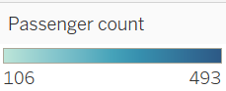
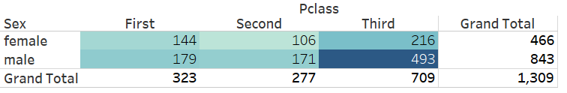
Who travelled in the Titanic? #gender #pclass
Contingency table showing count of female and male passengers distinguished by their P-class cabins.
Unpacking the visual:
Females from second class are lowest in count, while males from third class are highest.
Notes:
As you would have realized, this analysis seems to be inclined towards the overlaps between gender and p-class dynamics.
This contingency table is an attempt to bring together the two variables. The rows display the binary genders while each column show each of the P-class.
The color legend helps us notice maximum and minimum values. We see that males from 3rd class were highest in number, while there were only 106 females from Second class making them lowest in count.

Slide 10
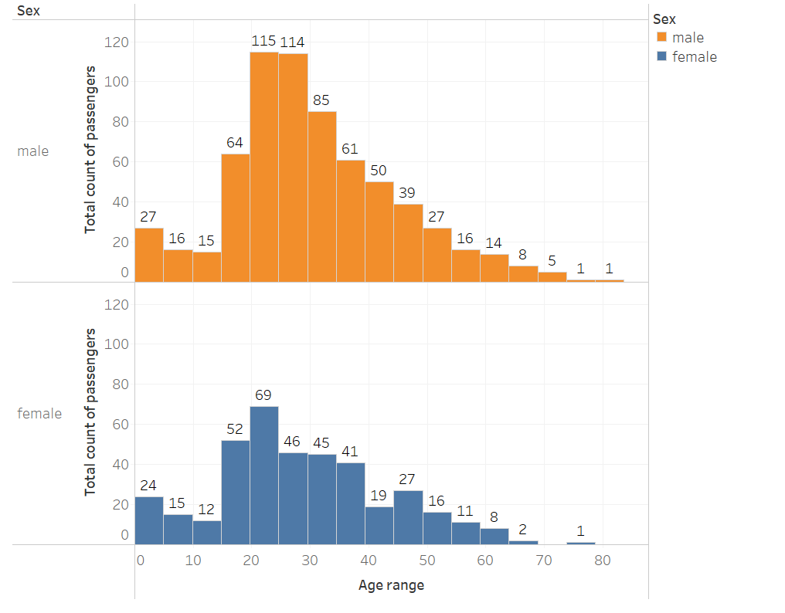
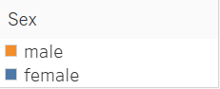
Who travelled in the Titanic? #gender #age
Histogram depicting passenger count over age range for males and females.
Unpacking the visual:
Age ranges from 0-85 years
Common x-axis for both histograms.
Majority of passengers are between 20-30 years for both genders.

Slide 11
Who survived?
Now that we have a basic understanding of who travelled in RMS Titanic at the time of the disaster, it is time to dive deep and find insights about who survived the catastrophe.
This second half of the data story will attempt to find who survived based on two aspects.
P-class
Gender
Notes:
Now that we have a better understanding of the passengers, specifically, their gender and P-class, it is time to find out who survived.

Slide 12
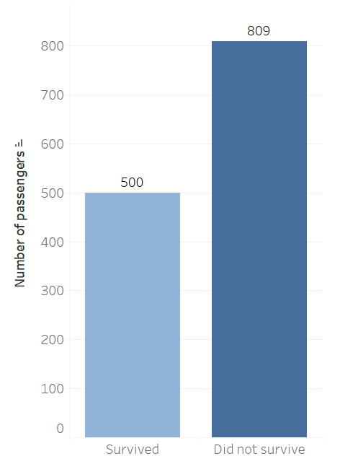
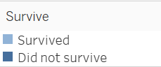
Who survived?
Bar chart representing the survival count of passengers in RMS Titanic
Unpacking the visual:
Horizontal axis represents the survival category.
Vertical axis shows the number of passengers.
Out of 1309 passengers, only 500 survived (38% approx.)
Notes:
This bar chart displays survival count of passengers in RMS Titanic.
X-axis represents the categorical variable and shows the count of passengers who survived or didn’t survive.
Y-axis shows the count of passengers.
This bar chart gives the big picture of who survived vs. who didn’t. It doesn’t go into too much detail, rather lays a good foundation and conveys the magnitude.

Slide 13
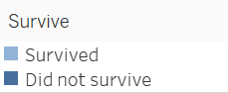
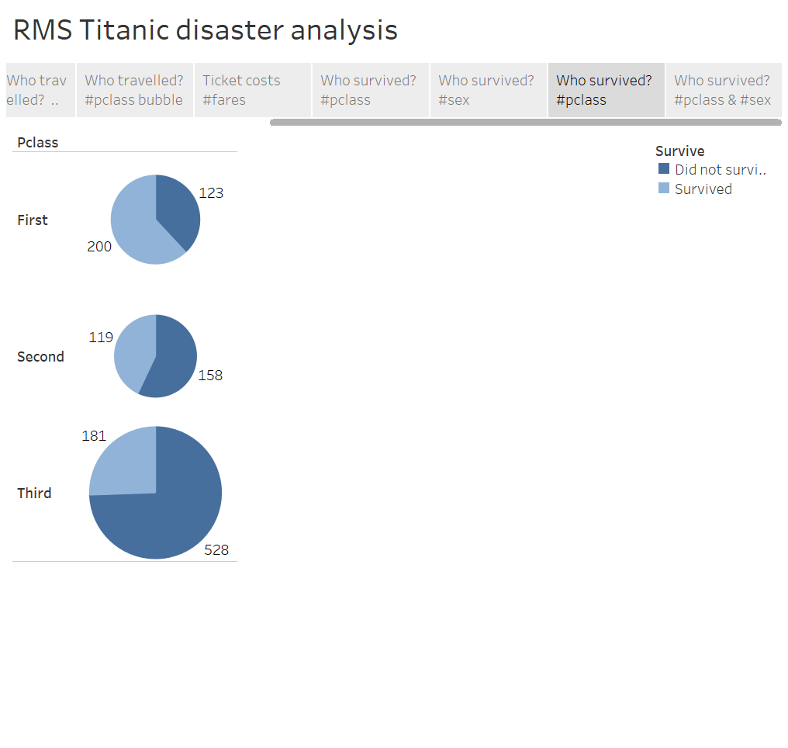
Who survived? #pclass
Pie chart representing the survival count of passengers in RMS Titanic depending on their P-class cabins.
Findings:
About 75% of Second-class passengers were alive at the end.
About 62% of passengers from First class survived the disaster.
Only 25% of Third-class passengers survived.
Refer to this slide for percentage calculation.
Notes:
I would like you to think that the series of visualizations is to help narrow us down to getting our answer. Now, it is like the second layer.
This pie chart shows survival count of passengers depending on the P-class cabins. The color legends further help visualize the magnitude of survival chances.

Slide 14
Who travelled in the Titanic? #pclass
Bar chart representing total passenger count based on P-class on RMS Titanic
Unpacking the visual:
Horizontal axis represents the 3 p-classes
Vertical axis shows the number of passengers in each p-class
Third class has maximum passengers (~ 54%)
Second class has the least (~21%)
Notes:
First, I want to calculate how many passengers from each of the social class travelled in Titanic.
As we can see, this is a column bar chart that represents total passenger count distinguished by three different colors indicating the 3 classes.

Slide 15
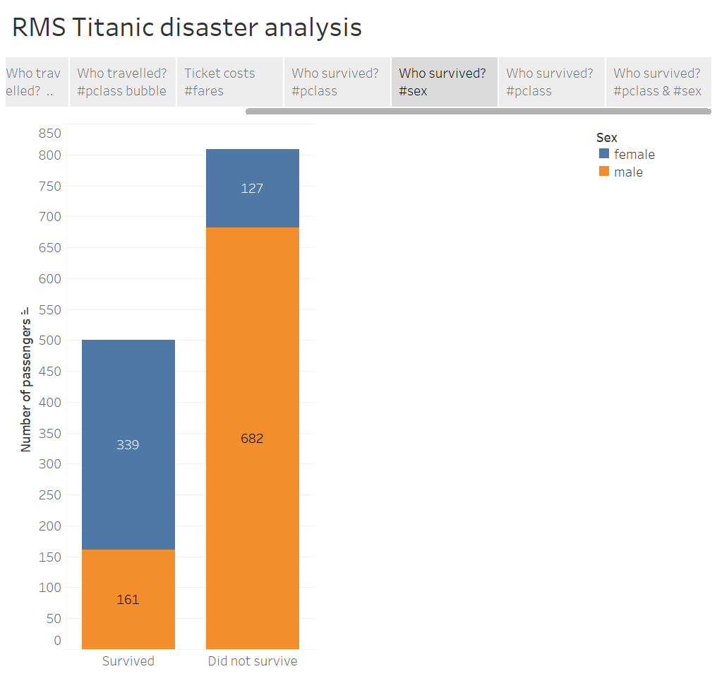
Who survived? #gender
Bar chart showing survival count of male and female passengers on RMS Titanic.
Findings:
Out of 466 females, 339 (73% approx.) of them survived.
However, out of 843 total male passengers, only 161 (19% approx.) survived.
Refer to this slide for more background context.
Notes:
This could be thought of as the third layer of our analysis.
This is a bar chart that displays survival chances depending upon gender. Again, since this is a stacked bar chart, the color legends happen to help a lot to get a quick overview of the magnitude. And I think, the labels also really help us in understanding it.
With a quick scan, we can see that comparatively females have had a better chance of surviving the disaster than males.
But again, thinking with proportions, there are already lesser females than males, it is essential to be mindful of that while calculating percentages.

Slide 16
Who travelled in the Titanic? #gender
Table showing the distinct counts of females and males in the ship.
Number of males on the ship were almost 55% higher in proportion than number of females.
Notes:
Slightly transitioning from P-classes, I want to give some insights into the gender composition in the ship at the time of the disaster.
This table shows distinct counts of females and males in Titanic. As we can see, females are relatively less in number compared to males.
Precisely, number of males was almost 55% higher than females.

Slide 17
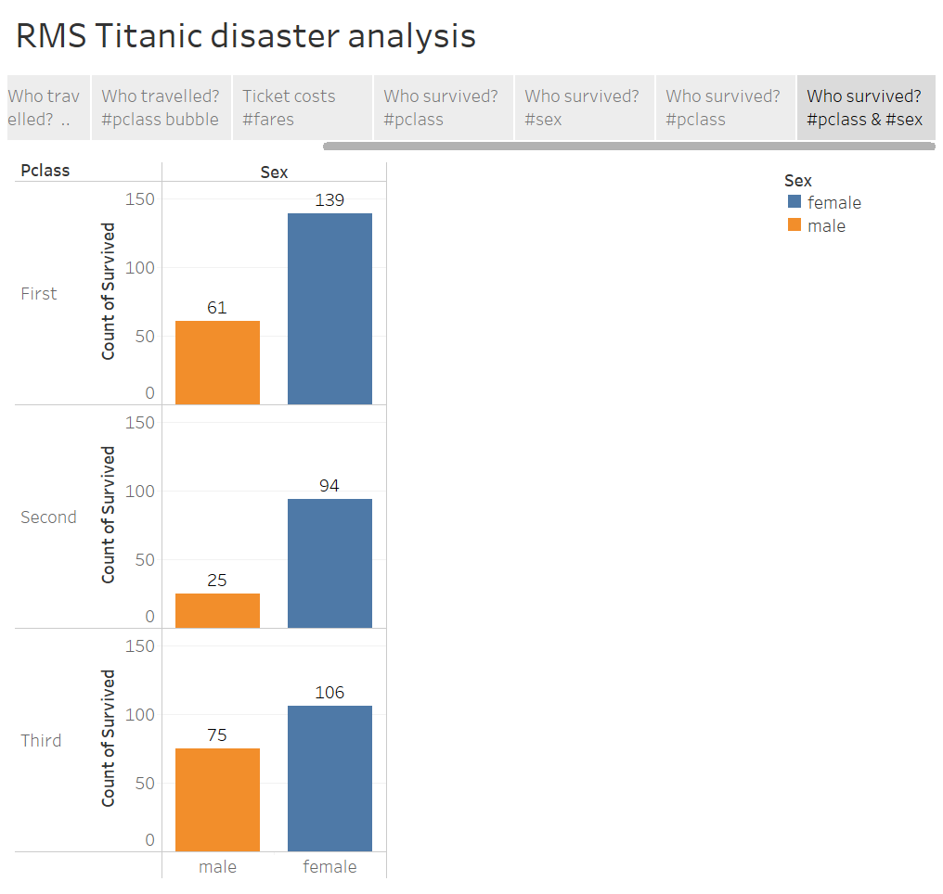
Who survived? #pclass #gender
A 3-tier bar chart divided by P-classes shows survival count of male and female passengers.
Findings:
Number of female survivors > male survivors.
27.8% of females from First-class survived among all other passengers making it the highest.
Only 5% of Second-class men were saved.
See this contingency table for full calculation.
Notes:
This is the final data viz for this presentation. It combines the two important variables, P-class and gender, that are essential for answering my research question.
We can see a 3-tiered bar chart that is separated based on the 3 p-classes and is further split by color into the two genders.
I think this chart provides an insight into just the people who survived to make fair comparisons.
It is very evident at this point that number of female survivors is significantly higher than males.

Slide 18
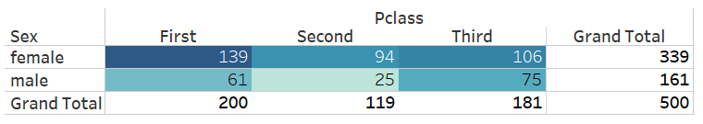
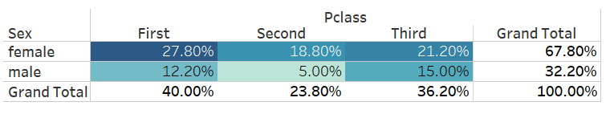
Who survived? #pclass #gender
Contingency table displaying survival count between males and females depending upon their respective P-classes.
Raw data
Percentage conversion

Slide 19
Takeaways
At the end of Titanic disaster,
Survival rate for females is relatively higher than that of males.
Specifically, it is identified that women who travelled as part of the First-class had more access to save themselves from the disaster.
Third class faced maximum loss due to the disaster. It is understandable because of their large occupancy in the ship as well.

Slide 20
Thank you for your time.

Slide 21
A 3-tier bar chart divided by P-classes shows survival count of male and female passengers.

